Slide 1
CBI NI People & skills Forum
A&L Goodbody, Belfast
19th March 2019

Slide 2
Agenda at a glance
Time | Agenda item
12:30 — 12:35 | Welcome and introductions
12:35 — 12:45 | CBI NI Immigration Economic Impact Report
12:45 — 14:00 | Home Office Presentation and Discussion
14:00 — 14:25 | CBI UK Overview and Discussion
14:25 — 14:30 | Any Other Business and Close
Chair. Sam Davidson, Group Human Resource Director, Henderson Group

Slide 3
CBI NI Immigration Economic impact report
Dr Owen Sims
Senior Policy Advisor, CBI

Slide 4
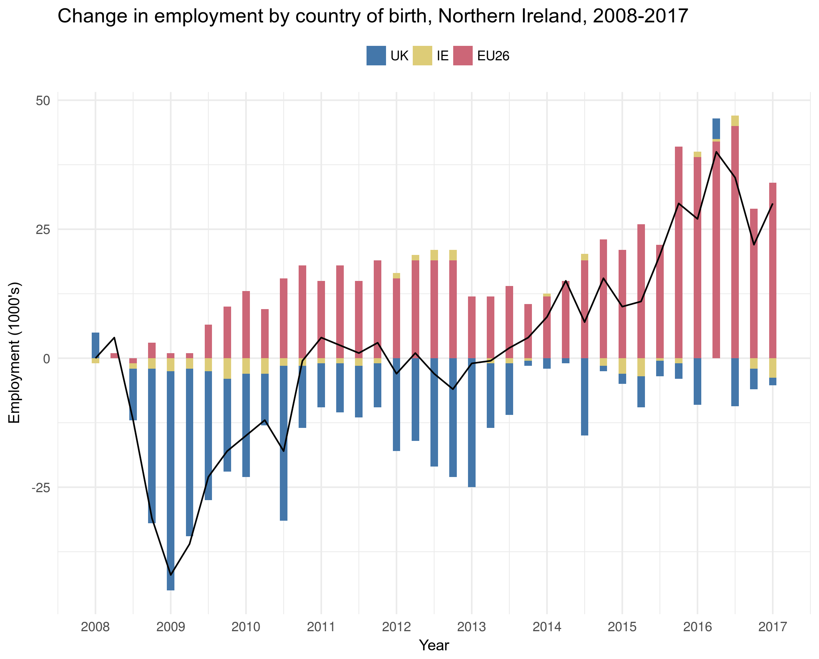
Contribution to employment
The global financial crisis (2008/2009) brought with it a structural change to the make-up of the NI labour market.
Over the past decade migrant workers from EU economies have driven employment in NI beyond the pre-crisis levels.
Increasingly filling skills gaps through all levels of occupational complexity.
NI has welcomed 38,000 migrants to work within its borders over the past 10 years.

Slide 5
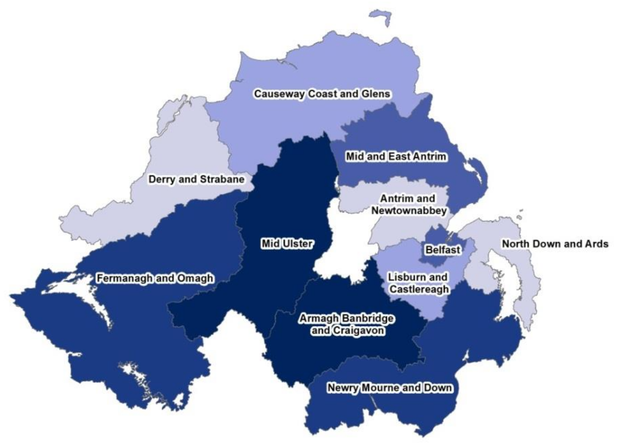
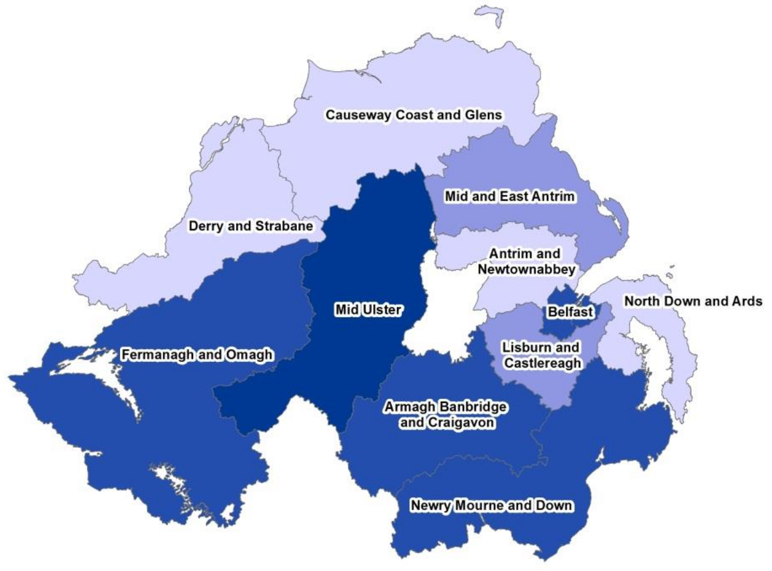
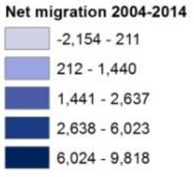
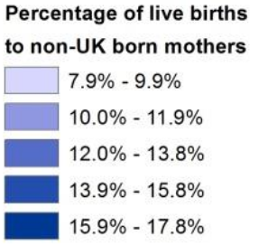
Geography of Migrant inflows
Net international migration by district, 2006–2016
Births to non-UK mothers by district, 2006–2016
Overall, 8% of Northern Ireland’s population was born overseas (149,000 people) – 5.5% from the EEA and 2.5% from the rest of the world.

Slide 6
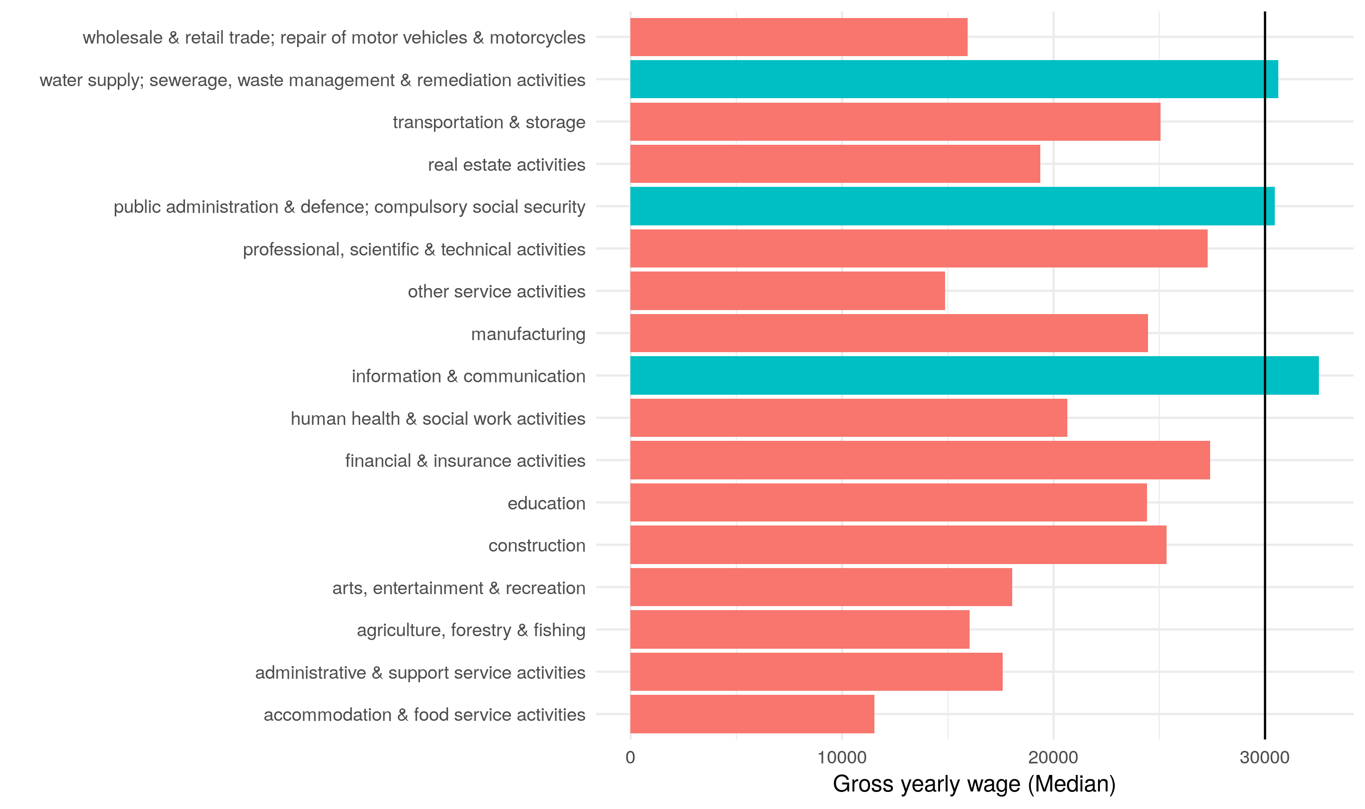
Threshold: Average industry wages in NI
The median (mean) wage in Northern Ireland is £22,016 (£25,704) compared to the UK’s £24,006 (£29,832).
Taking median wages, 83% of industries currently do not provide a salary equal to or above £30,000.
This is compared to 55% of industries, on average, in the UK as a whole.
Importantly, 37% of workers in food and drink manufacturing and 11% in manufacturing are EEA nationals.

Slide 7
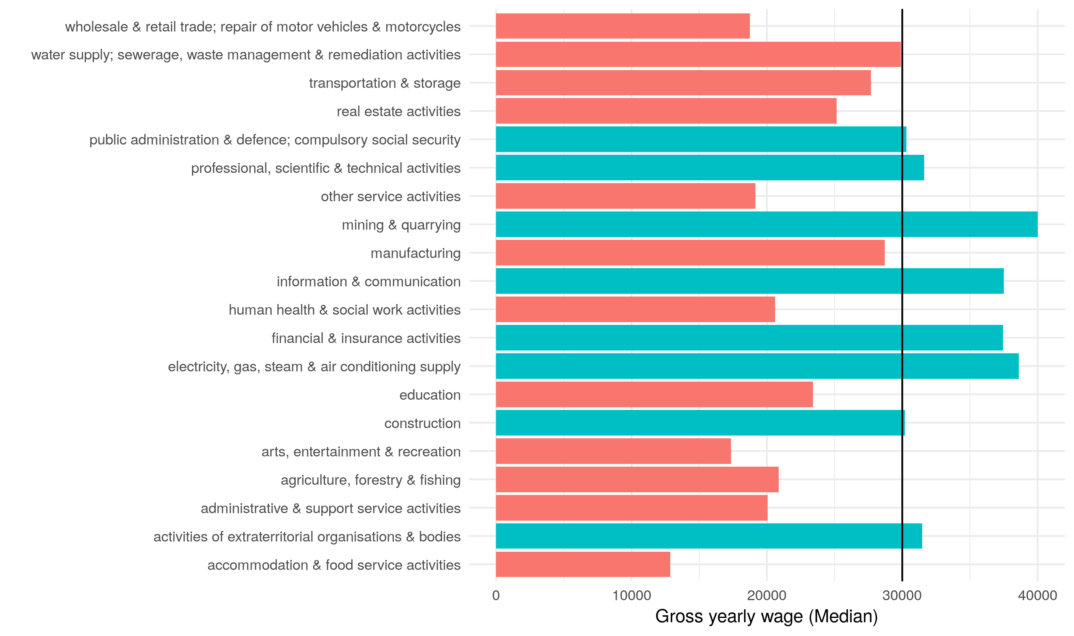
Threshold: Average industry wages in UK
The median (mean) wage in Northern Ireland is £22,016 (£25,704) compared to the UK’s £24,006 (£29,832).
Taking median wages, 83% of industries currently do not provide a salary equal to or above £30,000.
This is compared to 55% of industries, on average, in the UK as a whole.
Importantly, 37% of workers in food and drink manufacturing and 11% in manufacturing are EEA nationals.

Slide 8
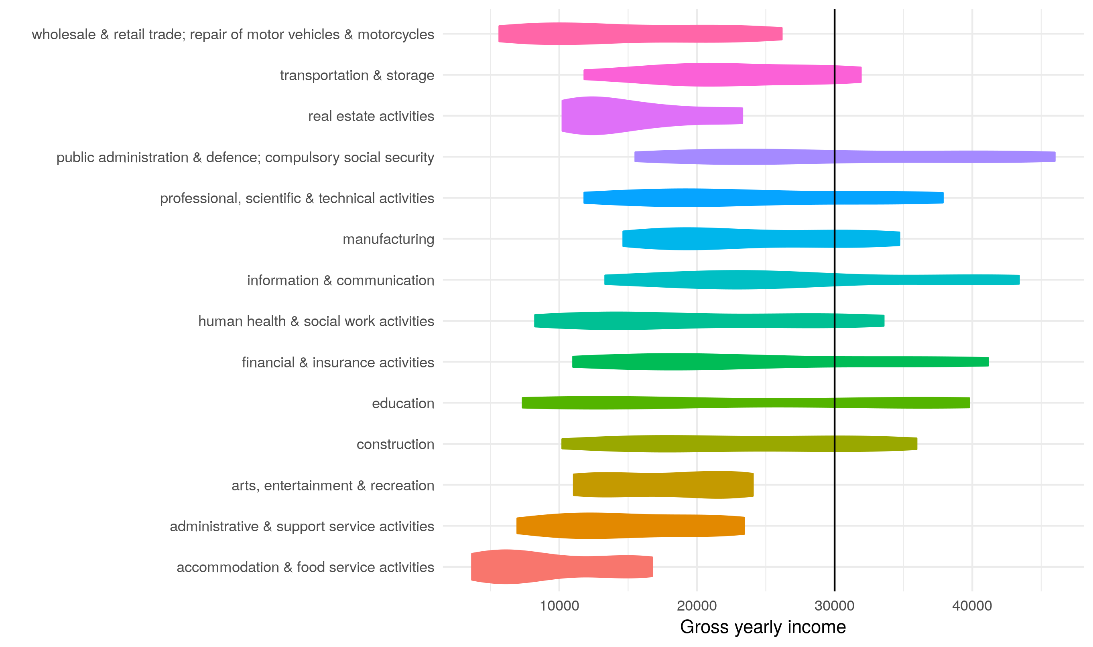
Threshold: Industry wage distributions in NI
The distribution of wages in NI shows that:
Even at the top scale, 35% of industries would not be open to migrant workers even at the top end of the wage scale.
Other industries require workers to be in the upper 60%-70% to be open to migrant workers.
A lot of wage data is missing in Northern Ireland compared to the rest of the UK.
The public sector provides the most prosperous wages; even compared to growth sectors, such as Information & Communication.

Slide 9
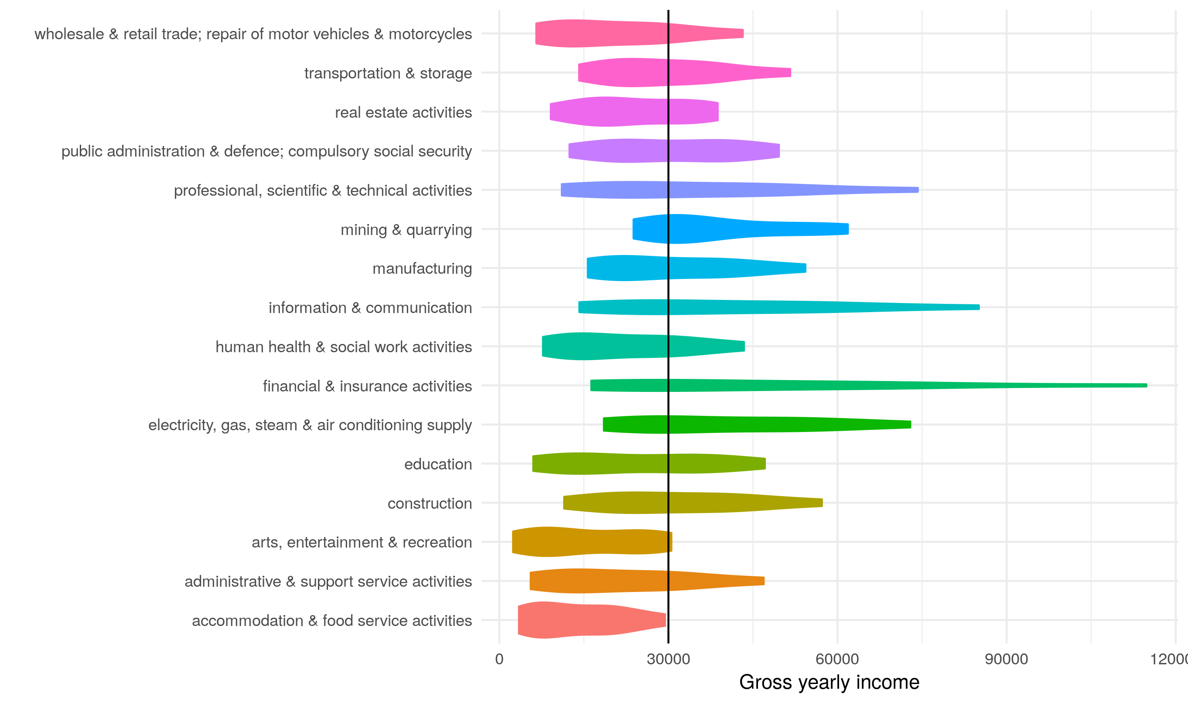
Threshold: Industry wage distributions in UK
Significantly different to the UK average.
Basically all industries can facilitate migrant labour at some level.
The composition of industry wages is remarkably different: financial & insurance activities, construction and manufacturing are more prosperous.
Importantly, public sector wages do not dominate other sectors.

Slide 10
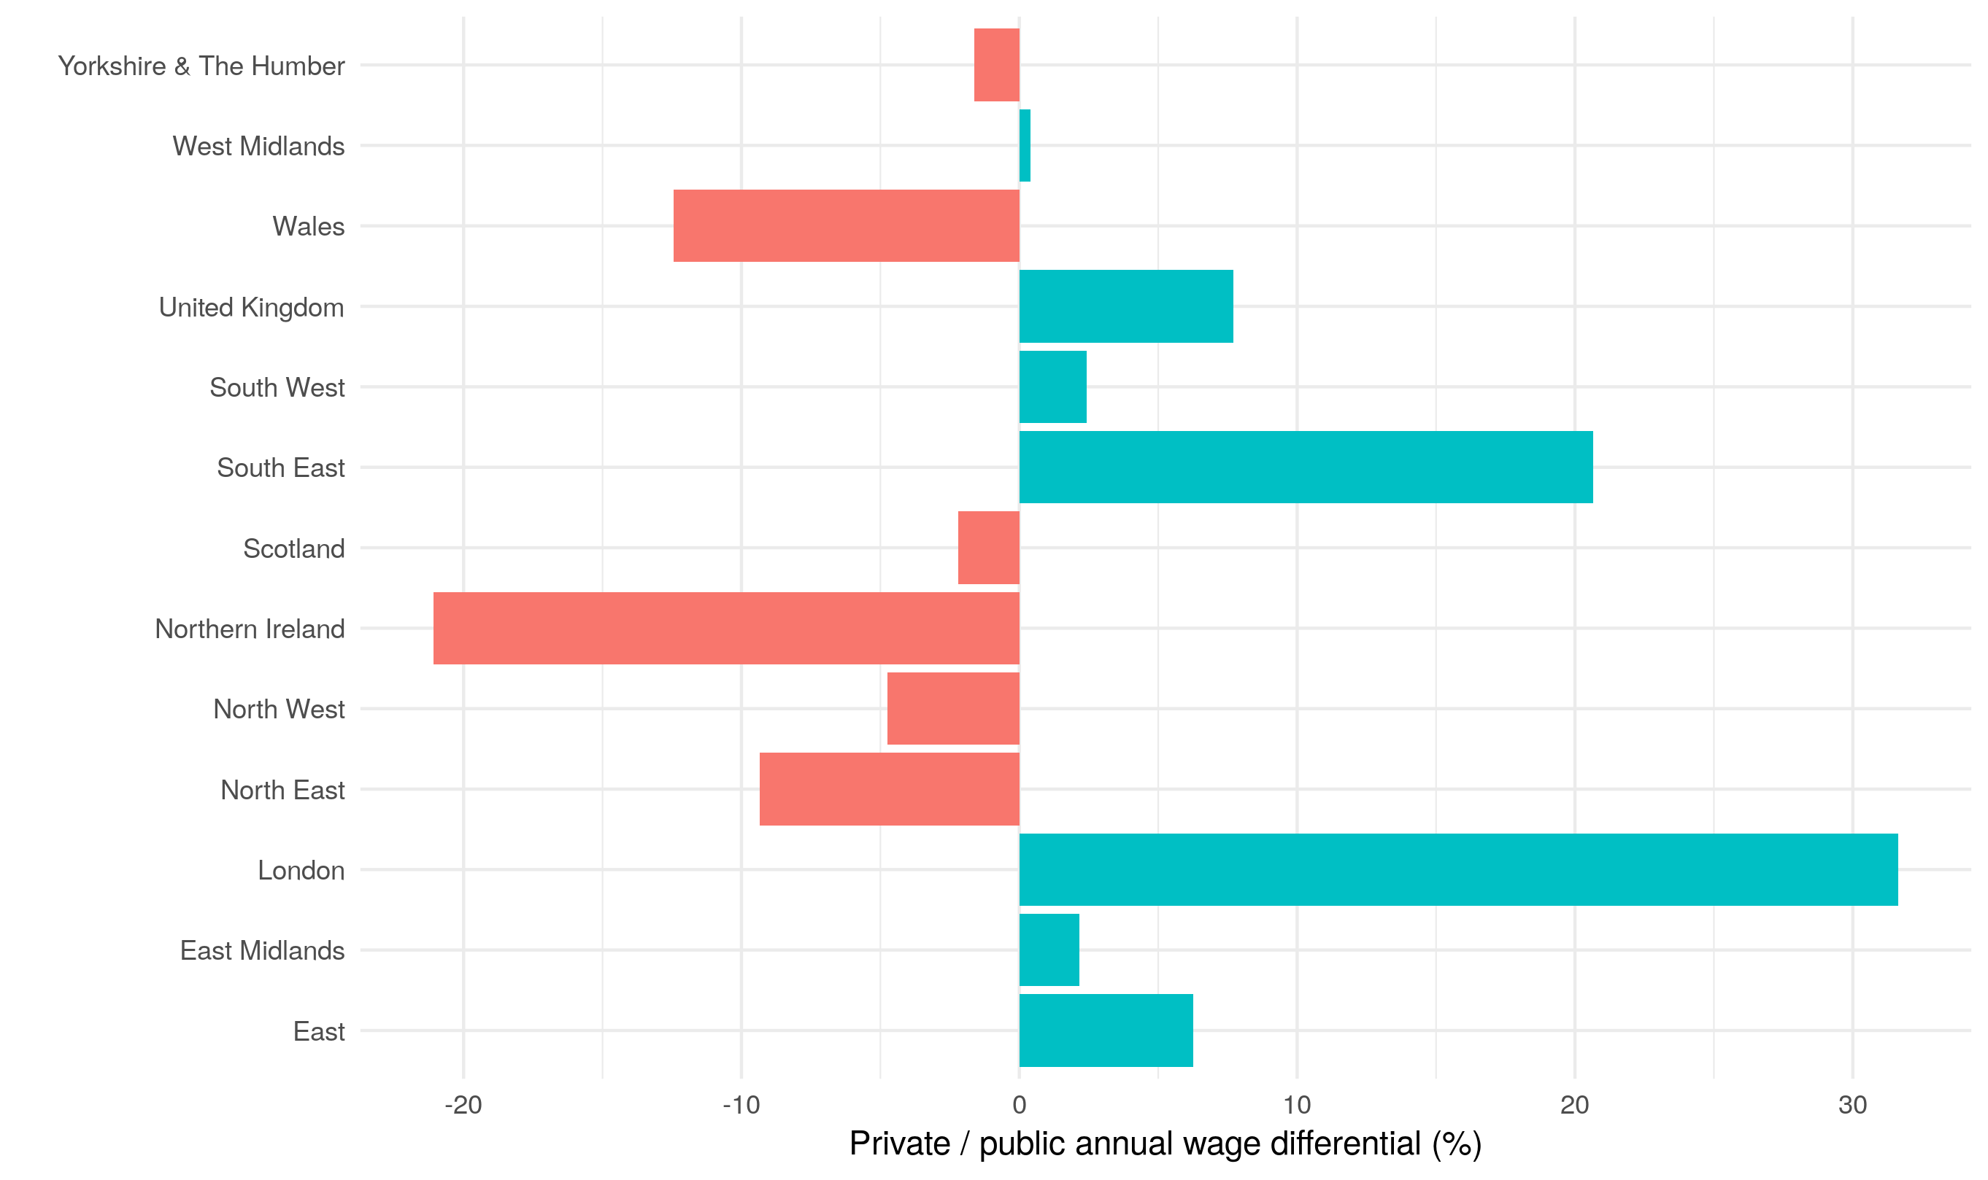
Threshold: Public / Private wage differential
Public sector wages distort the averages for NI compared to the rest of UK.
Average wages in the private sector are typically over 20% lower in NI compared to public sector wages. This is a real anomaly.
Taking this into account, the median (mean) wage in NI private sector is £19,738 (£22,713) compared to the UK’s £23,628 (£30,779).

Slide 11
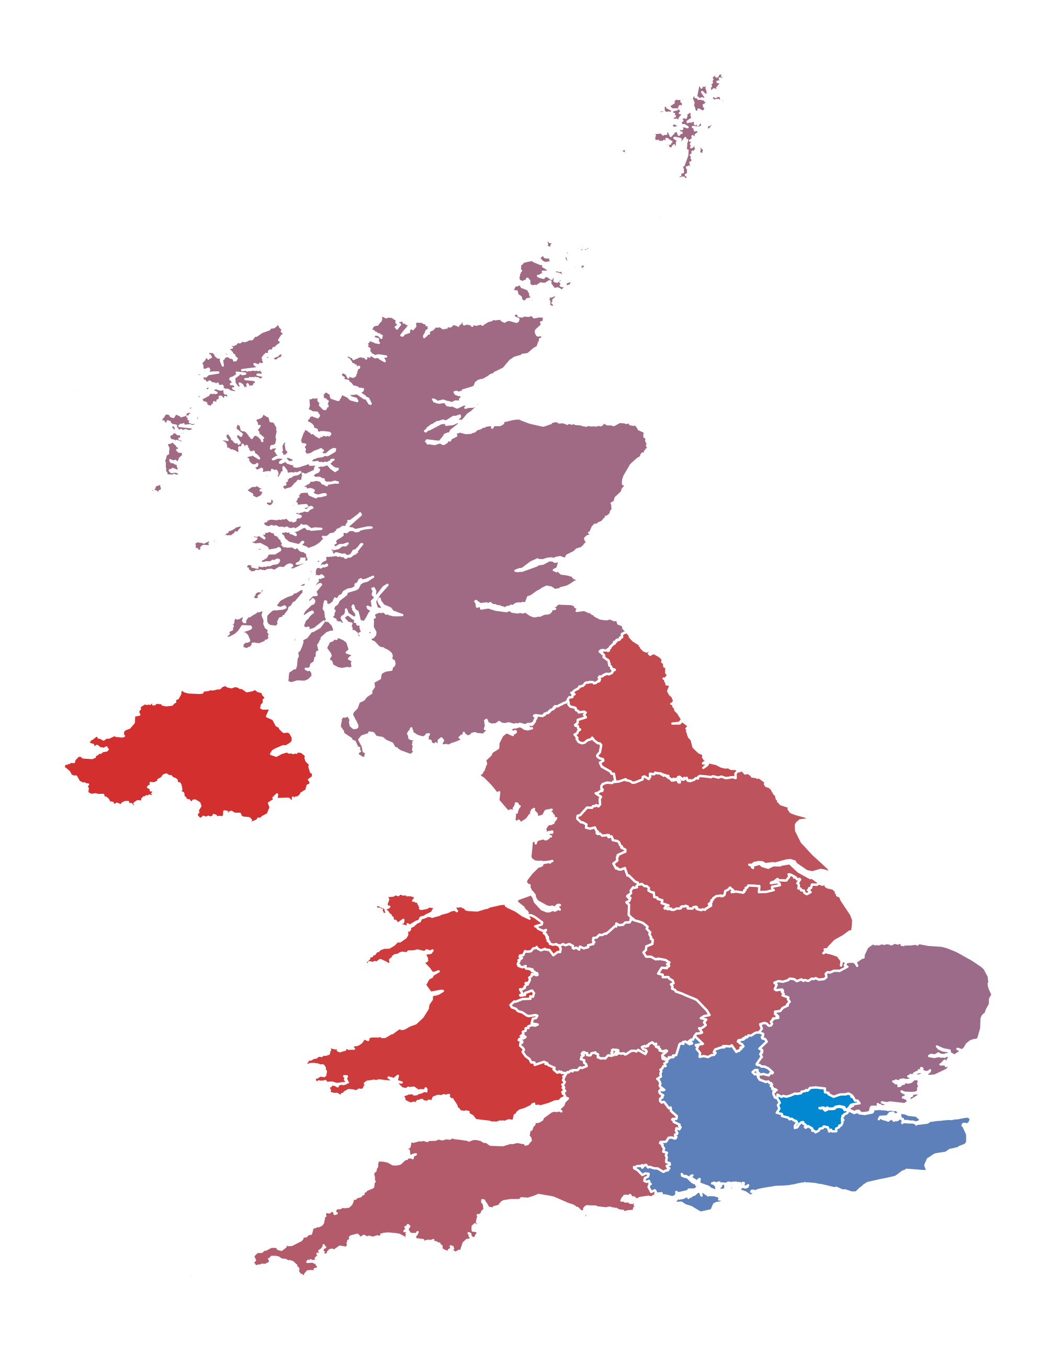
Threshold: Impact throughout the UK
Using this public/private differential, combined with the mean wages from the throughout the UK we can mock up what regions will be impacted in the short-run.
Although NI seems to be impacted the most, particularly since industries impacted the most have the highest output and employment multipliers and supply chains throughout the Island.
It is not the only region.

Slide 12
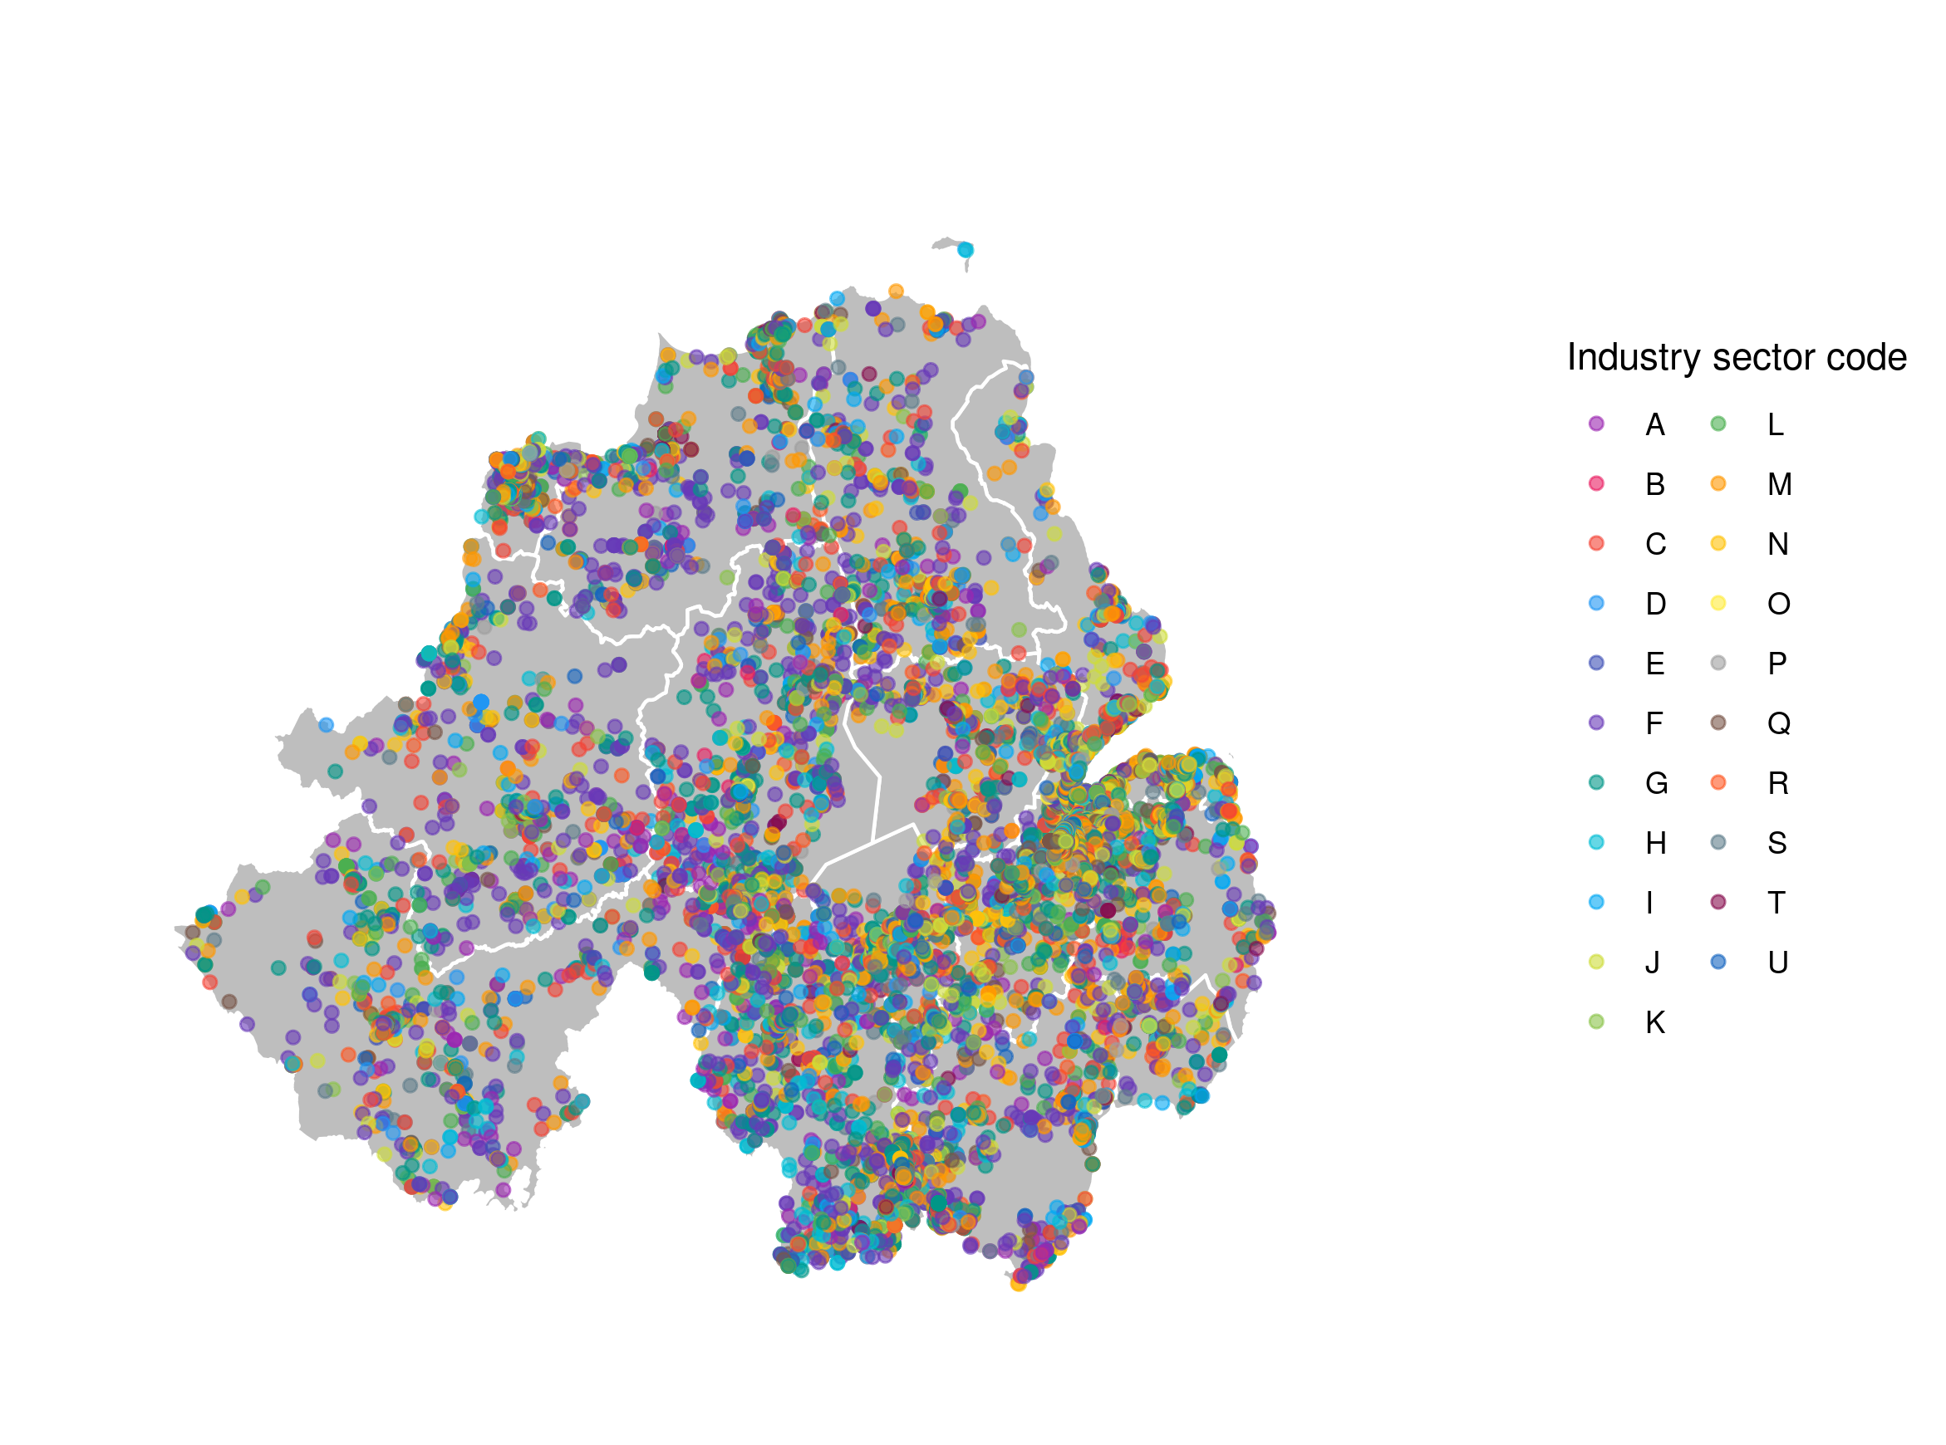
Most impacted areas in Northern Ireland (1)
Geolocation of all NI companies registered with Companies House, 2019
Companies House have a very nice API, which can be used to request data on all firms operating in NI and across the UK.
Each company registers a 5-Digit SIC code, which can be aggregated up to the industry sectors, like, Communication and Information.
Also able to extract balance sheet data (by parsing PDFs).

Slide 13
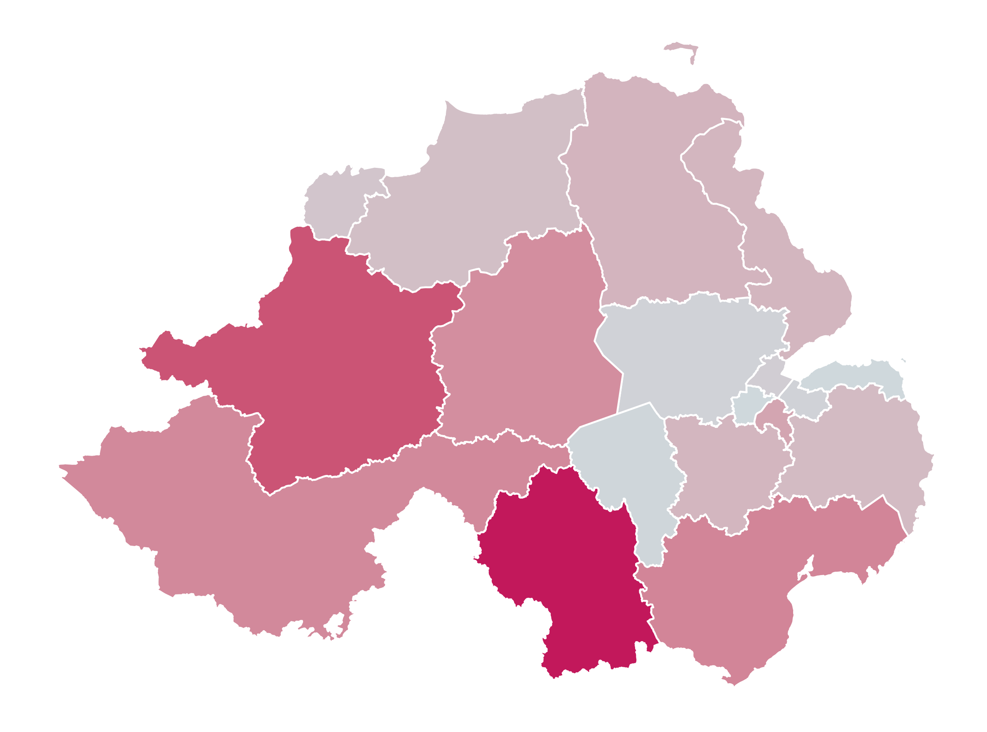
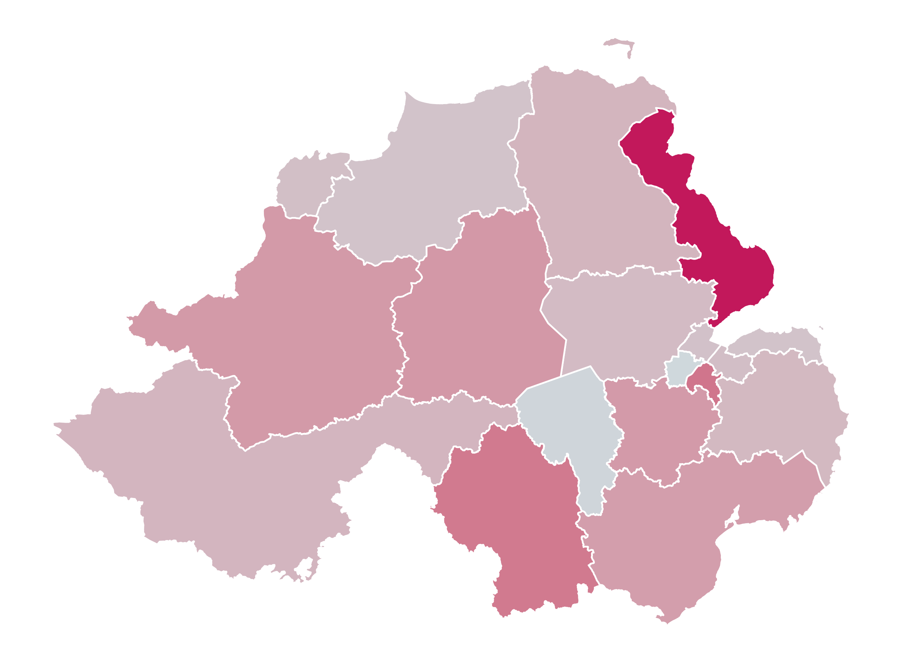
Most impacted areas in Northern Ireland (2)
Heatmap of short-term impact for Agriculture
Heatmap of short-term impact for Manufacturing

Slide 14
Any questions?

Slide 15
CBI NI Immigration Economic impact report
Tom Barrett
Senior Policy Advisor, CBI

Slide 16
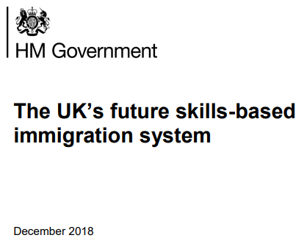

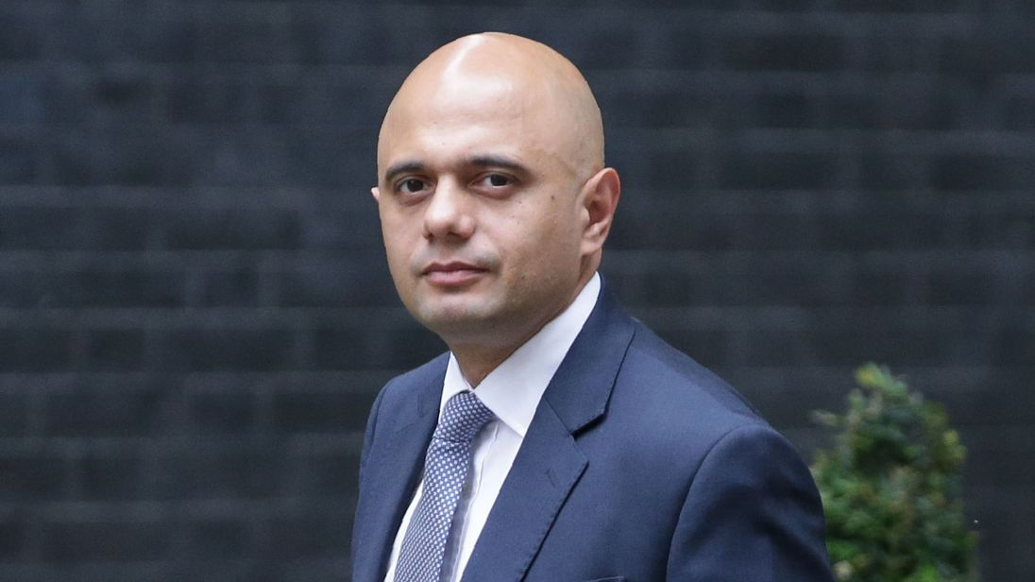
THE Immigration White paper is progress from mac report but fails to meet business needs
CBI influencing in between the Migration Advisory Committee
(MAC) report and White Paper successfully curbed most restrictive proposals initially feared...
The MAC report published in September 2018 recommended retention of the £30,000 salary threshold and no route for low-skilled workers below this.
CBI firmly resisted these proposals both publicly (CBI Annual Conference) and through a series of meetings with officials and Ministers across government.
As a result, the White Paper published in December 2018 doesn’t commit to £30,000, but instead further consultation with business, and does include a route to access labour regardless of skill or salary level, albeit temporary.
… but the White Paper still fails to meet the needs of the economy
Whilst removal of the 28 day Resident Labour Market test, scrapping the cap on skilled visas, and radical reform of sponsorship system are all welcome, serious concerns remain over:
Salary threshold – it might be lower than £30k, but a salary threshold is inevitable. Influencing its level will require trade-offs
12-month temporary visa – while government sees any route as a concession, businesses are clear that this doesn’t go far enough
£1,000 immigration skills charge and £400 health charge – retention of these charges will make the immigration system inaccessible to most of firms
Radical reform is welcome but a significant risk it may not come in time – the new system must be accessible from ‘Day 1’ and tweaks to Tier 2 avoided

Slide 17
IT MAY BE TIME TO ADOPT MORE DETAILED POLICIEs
CBI will formally respond to the immigration White Paper. To do so we must consider whether it is time yet to commit publicly to compromise proposals, or continue with the strategy of highlighting concerns and explaining principles that are important to businesses in the hope that a better deal becomes possible.
If it is time to commit to policy details then options could include:
Lower salary threshold
Flexibility on salary via shortage occupation lists
Roles on shortage occupation list (SOL) benefit from lower salary thresholds
Longer temporary route ‘below the line’
Extend from 12 to 24 months and reduce ‘cooling off’ period to 6 months
Be able to switch from temporary into skilled visa route (if meet the criteria)
Free movement continues until new system is ready
A) Lower to the principle of UK median wage (£24,006), or;
B) Salary thresholds linked to skill levels, set at 25th percentile to prevent wage undercutting (Level 6 at £30k, Level 4-5 at £24k, Level 3 at £20k)
Reform of the MAC (i.e. LPC or OBR model) and better process to set SOL
Flexibility for devolved nations via Scotland & Northern Ireland specific SOLs
Commitment that status quo (i.e. free movement) continues until the new system is ready. Rule out option of minor tweaks to current non-EEA system if radical reforms are not deliverable by the end of transition (31 Dec 2020)

Slide 18

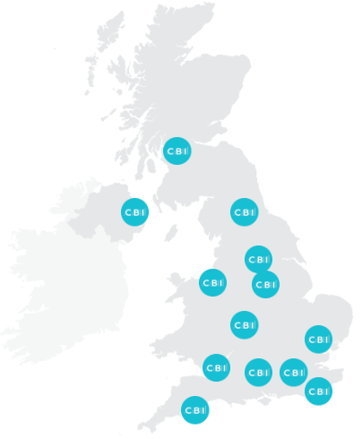
2019 campaign and member engagement plan
Keep up the public campaign ‘drumbeat’ on most politically charged elements of the proposed new system
Government is unlikely to take political decisions on the level of salary threshold and length of temporary route until late 2019. But to achieve desired outcomes it will be important to maintain public pressure throughout 2019 via:
Enhanced focus on MPs and Parliament – with Immigration Bill currently going through Parliament and Home Affairs Committee remaining influential (i.e. Matthew Fell oral evidence to Bill Committee – 12 February)
Regular CBI public interventions via media and events – continued use of CBI speeches and events, plus external announcements, to land key immigration messages in the media (i.e. regional press coverage on £30k analysis in February)
CBI response to immigration White Paper – earmark our response as a major media hook to land messages publicly as well as with Government
Support the Home Office engage with business in the regions and nations, as well as technical input on system design
Whilst political decisions are unlikely to be taken soon, the CBI can play a constructive role in supporting Home Office officials to create a system that meets business needs:
CBI roundtables with Home Office across regions and nations – support Home Office officials to hear directly from business via CBI organised events
Provide evidence on technical design a new system – help to create the framework of the new system in Q1/2 by providing evidence on practical aspects, for example sponsorship reform and business traveller rules

Slide 19
Questions for today
Purpose
Check-in on priorities for CBI lobbying position to inform response to the government’s White Paper
Should the CBI start making more detailed policy recommendations or continue to stick to high level principles?
What factors should we take into account when recommending a salary threshold?
Should we focus efforts relating to lower skilled migration on longer visas and the ability to switch to a skilled worker visa, or on other reforms?
How strongly should the CBI resist the potential that a modified version of the current non-EU migration system is temporarily introduced until the full package of reforms can be completed?

Slide 20
Any questions?

Slide 21
Any Other Business

